Slide 1
STREAMIFY
STREAMIFY
PRANJAL SHARMA
SHEFALI MOHAPATRA

Slide 2
Index
Acknowledgment
Overview of the Project
ER model
Table descriptions
Relationships
Assumptions to ER model
Functional dependencies
Normalization and Normal forms
Creation of Tables
Inserting values
Queries

Slide 3
Acknowledgment
We would like to express our heartfelt gratitude to our DBMS Professor, Prof. T. Ramakrishnudu, and Dr. R. B. V. Subramanyam for providing this opportunity which helped us to broaden our understanding of database concepts. We are truly thankful for their teachings and lectures which helped us to develop this project.

Slide 4
A Comprehensive Database Management System for Streaming Services
Overview
Streamify is a sophisticated Database Management System that has functionalities of popular streaming services like Netflix. The project aims to provide a scalable database model for managing user profiles, content catalogs, and user-content interactions.
Goals
The project's primary goal is to create a well-constructed DBMS for streaming services that provides a smooth user experience with efficient content management. The project demonstrates proficiency in database design and effectively utilizing algorithms for recommendation systems.

Slide 5
ER MODEL

Slide 7
Relationships
Users and Subscription have a MANY-TO-ONE relationship.
Users and WatchProfile have a ONE-TO-MANY relationship.
WatchProfile and Content have a MANY-TO-ONE relationship.
Content and Actor have a MANY-TO-MANY relationship.
Content and Director have a MANY-TO-MANY relationship.
Content and Genre have a MANY-TO-MANY relationship.

Slide 8
Assumptions of er model
Users is a strong entity set that stores the details of every registered user which includes personal details as well as payment details. Its primary key is “UserID”.
Every user must have a subscription.
Content is a strong entity set that stores the details of the movies/web series that are offered by the platform. Its primary key is “ContentID”.
WatchProfile is a weak entity set that is dependent on the two strong entities Users and Content. Its primary key includes “ProfileType”, “UserID” and “ContentID”.
Genre is a strong entity set that stores information about each genre of the shows available on the platform. Its primary key includes “GenreID”.
Director is a strong entity set that stores personal and professional information. “DirectorID” is its primary key.
Actor is a strong entity set that stores personal and professional information. Its primary key is “ActorID”.

Slide 9
Er model to
relational model :
Table description

Slide 10
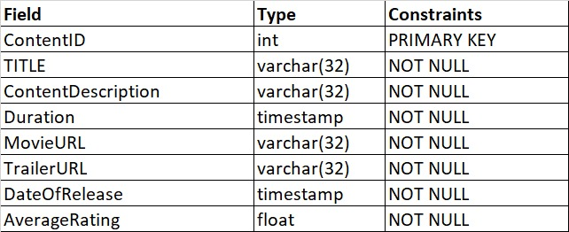
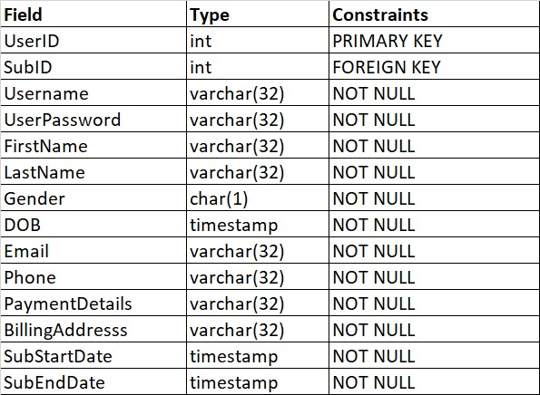
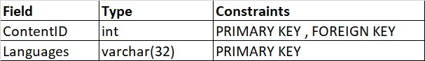
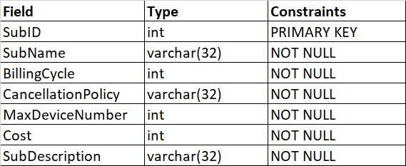
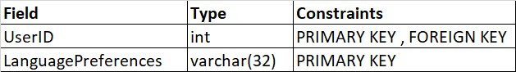
Contents
Users
Content_Language
Subscription
User_Language

Slide 11
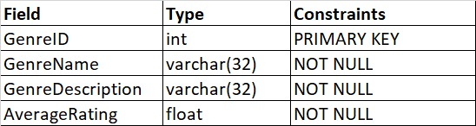
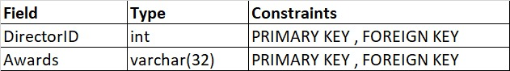
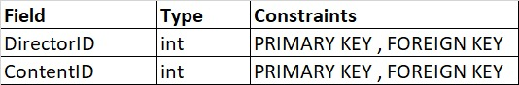
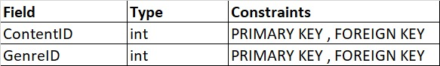
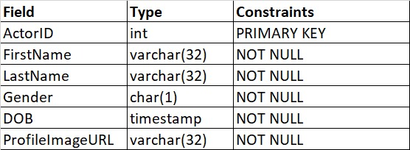
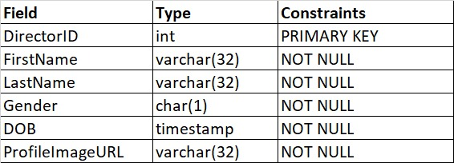
Genre
Director_Awards
BelongsTo
Directed
Director
Actor

Slide 12
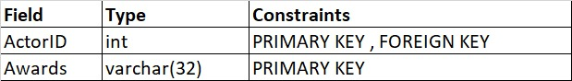
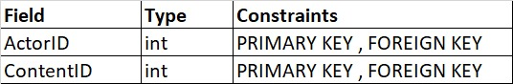
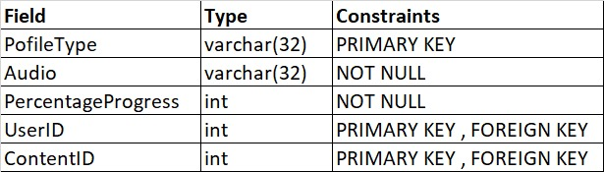
Actor_Awards
PerformedIn
WatchProfile

Slide 13
Functional dependencies and normalization

Slide 14
Users (in 4th normal form)
UserID → SubID, Username, UserPassword, FirstName, LastName, Gender, DOB, Email, Phone, PaymentDetails, BillingAddress, SubStartDate, SubEndDate
Subscription (in 4th normal form)
SubID → SubName, BillingCycle, CancellationPolicy, MaxDeviceNumber, Cost, SubDescription
Users_Language (in 4th normal form)
UserID, LanguagePreferences → UserID, LanguagePreferences
Content (in 4th normal form)
ContentID → Title, ContentDescription, Duration, MovieURL, TrailerURL, DateOfRelease, AverageRating
Content_Languages (in 4th normal form)
ContentID, Languages → ContentID, Languages

Slide 15
Genre (in 4th normal form)
GenreID → GenreName, GenreDescription, AverageRating
BelongsTo (in 4th normal form)
ContentID,GenreID → ContentID,GenreID
Director (in 4th normal form)
DirectorID → FirstName, LastName, Gender, DOB, ProfileImageURL
Director_Awards (in 4th normal form)
DirectorID, Awards → DirectorID, Awards
Directed (in 4th normal form)
DirectorID, ContentID → DirectorID, ContentID

Slide 16
Actor (in 4th normal form)
ActorID → FirstName , LastName , Gender , DOB, ProfileImageURL
Actor_Awards (in 4th normal form)
ActorID, Awards → ActorID, Awards
Performed (in 4th normal form)
ActorID, ContentID → ActorID, ContentID
WatchProfile (in 4th normal form)
UserID, ContentID, PofileType → Audio, PercentageProgress

Slide 17
Normalization and Normal forms
Normalization is used to minimize the redundancy from a relation or set of relations. It is also used to eliminate undesirable characteristics like Insertion, Update, and Deletion Anomalies. Normalization divides the larger table into smaller ones and links them using relationships.
In this database, all the relations are in 4th normal form.
There are no multivalued attributes in any tables so it satisfies 1st normal form.
There are no partial dependencies so it also satisfies the 2nd normal form.
There are no transitive dependencies. Hence it also satisfies the 3rd normal form.
It satisfies BCNF as LHS of all functional dependencies is a candidate key or super key. In fact the LHS of all the functional dependencies is a primary key.
There are no multivalued dependencies in the relation. Hence it satisfies the 4th normal form.

Slide 18
Creation of tables

Slide 19
CREATE TABLE SUBSCRIPTION(
SubID INT,
SubName VARCHAR(32),
BillingCycle INT,
CancellationPolicy VARCHAR(32),
MaxDeviceNumber INT,
Cost INT,
SubDescription VARCHAR(32),
PRIMARY KEY(SubID)
);
CREATE TABLE USERS_LANGUAGE(
UserID INT,
LanguagePreferences VARCHAR(32),
FOREIGN KEY(UserID) REFERENCES USERS(UserID),
PRIMARY KEY(UserID,LanguagePreferences)
);
CREATE TABLE USERS(
UserID INT,
SubID INT,
Username VARCHAR(32),
UserPassword VARCHAR(32),
FirstName VARCHAR(32),
LastName VARCHAR(32),
Gender CHAR(1),
DOB DATE,
Email VARCHAR(32),
Phone VARCHAR(32),
PaymentDetails VARCHAR(32),
BillingAddresss VARCHAR(32),
SubStartDate DATE,
SubEndDate DATE,
FOREIGN KEY(SubID) REFERENCES SUBSCRIPTION(SubID),
PRIMARY KEY(UserID)
);

Slide 20
CREATE TABLE CONTENT(
ContentID INT,
TITLE VARCHAR(32),
ContentDescription VARCHAR(32),
Duration INT,
MovieURL VARCHAR(32),
TrailerURL VARCHAR(32),
DateOfRelease DATE,
AverageRating FLOAT,
PRIMARY KEY(ContentID)
);
CREATE TABLE CONTENT_LANGUAGES(
ContentID INT,
Languages VARCHAR(32),
FOREIGN KEY(ContentID) REFERENCES CONTENT(ContentID),
PRIMARY KEY(ContentID,Languages)
);
CREATE TABLE GENRE(
GenreID INT,
GenreName VARCHAR(32),
GenreDescription VARCHAR(32),
AverageRating FLOAT,
PRIMARY KEY(GenreID)
);
CREATE TABLE BelongsTo(
ContentID INT,
GenreID INT,
FOREIGN KEY(ContentID) REFERENCES CONTENT(ContentID),
FOREIGN KEY(GenreID) REFERENCES GENRE(GenreID),
PRIMARY KEY(ContentID,GenreID)
);

Slide 21
CREATE TABLE DIRECTOR(
DirectorID INT,
FirstName VARCHAR(32),
LastName VARCHAR(32),
Gender CHAR(1),
DOB DATE,
ProfileImageURL VARCHAR(32),
PRIMARY KEY(DirectorID)
);
CREATE TABLE DIRECTOR_AWARDS(
DirectorID INT,
Awards VARCHAR(32),
FOREIGN KEY(DirectorID) REFERENCES DIRECTOR(DirectorID),
PRIMARY KEY(DirectorID,Awards)
);
CREATE TABLE DIRECTED(
DirectorID INT,
ContentID INT,
FOREIGN KEY(DirectorID) REFERENCES DIRECTOR(DirectorID),
FOREIGN KEY(ContentID) REFERENCES CONTENT(ContentID),
PRIMARY KEY(DirectorID,ContentID)
);
CREATE TABLE ACTOR(
ActorID INT,
FirstName VARCHAR(32),
LastName VARCHAR(32),
Gender CHAR(1),
DOB DATE,
ProfileImageURL VARCHAR(32),
PRIMARY KEY(ActorID)
);

Slide 22
CREATE TABLE ACTOR_AWARDS(
ActorID INT,
Awards VARCHAR(32),
FOREIGN KEY(ActorID) REFERENCES ACTOR(ActorID),
PRIMARY KEY(ActorID,Awards)
);
CREATE TABLE PERFORMEDIN(
ActorID INT,
ContentID INT,
FOREIGN KEY(ActorID) REFERENCES ACTOR(ActorID),
FOREIGN KEY(ContentID) REFERENCES CONTENT(ContentID),
PRIMARY KEY(ActorID,ContentID)
);
CREATE TABLE WatchProfile(
ProfileType VARCHAR(32),
Audio VARCHAR(32),
PercentageProgress INT,
UserID INT,
ContentID INT,
FOREIGN KEY(UserID) REFERENCES USERS(UserID),
FOREIGN KEY(ContentID) REFERENCES C ONTENT(ContentID),
PRIMARY KEY(UserID,ContentID,PofileType)
);

Slide 23
INSERTING VALUES​

Slide 24
USERS
INSERT INTO USERS VALUES (1, 1, 'amit_patel123', 'amit_password', 'Amit', 'Patel', 'M', '1985-06-15', 'amitpatel@gmail.com', 7207696357, 'UPI', 'Mumbai', '2023-01-01', '2023-02-01’);
INSERT INTO USERS VALUES (2, 2, 'priya_sharma456', 'priya_password', 'Priya', 'Sharma', 'F', '1990-09-20', 'priyasharma@gmail.com', 7204596357, 'Card', 'Delhi', '2023-02-15', '2023-05-15’);
INSERT INTO USERS VALUES (3, 3, 'rahul_singh789', 'rahul_password', 'Rahul', 'Singh', 'M', '1988-04-10', 'rahulsingh@gmail.com', 7207696677, 'NetBanking', 'Bangalore', '2023-03-20', '2024-03-20’);
INSERT INTO USERS VALUES (4, 3, 'anita_verma101', 'anita_password', 'Anita', 'Verma', 'F', '1995-12-25', 'anitaverma@gmail.com', 7307696357, 'UPI', 'Kolkata', '2023-04-10', '2024-04-10’);
INSERT INTO USERS VALUES (5, 1, 'sandeep_gupta202', 'sandeep_password', 'Sandeep', 'Gupta', 'M', '1983-11-30', 'sandeepgupta@gmail.com', 7207696657, 'Card', 'Chennai', '2023-05-05', '2023-06-05’);
INSERT INTO USERS VALUES (6, 2, 'deepa_das303', 'deepa_password', 'Deepa', 'Das', 'F', '1992-08-12', 'deepadas@gmail.com', 7207556357, 'NetBanking', 'Hyderabad', '2023-06-25', '2023-09-25’);
INSERT INTO USERS VALUES (7, 2, 'raj_kumar404', 'raj_password', 'Raj', 'Kumar', 'M', '1986-03-18', 'rajkumar@gmail.com', 7677696357, 'UPI', 'Pune', '2023-07-30', '2023-10-30’);
INSERT INTO USERS VALUES (8, 1, 'neha_reddy505', 'neha_password', 'Neha', 'Reddy', 'F', '1989-07-05', 'nehareddy@gmail.com', 7277696357, 'Card', 'Jaipur', '2023-08-10', '2023-09-10’);
INSERT INTO USERS VALUES (9, 3, 'vikram_rao606', 'vikram_password', 'Vikram', 'Rao', 'M', '1991-05-08', 'vikramrao@gmail.com', 7205596357, 'NetBanking', 'Ahmedabad', '2023-09-15', '2024-09-15’);
INSERT INTO USERS VALUES (10, 1, 'pooja_malhotra707', 'pooja_password', 'Pooja', 'Malhotra', 'F', '1984-10-22', 'poojamalhotra@gmail.com', 7211696357, 'UPI', 'Lucknow', '2023-10-20', '2023-10-20');

Slide 25
USERS
INSERT INTO USERS VALUES (11, 1, 'rakesh_joshi808', 'rakesh_password', 'Rakesh', 'Joshi', 'M', '1993-02-28', 'rakeshjoshi@gmail.com', 7222696357, 'Card', 'Surat', '2023-11-01', '2023-12-01’);
INSERT INTO USERS VALUES (12, 2, 'sneha_choudhary909', 'sneha_password', 'Sneha', 'Choudhary', 'F', '1987-09-17', 'snehachoudhary@gmail.com', 7207236357, 'NetBanking', 'Kanpur', '2023-12-05', '2024-03-05’);
INSERT INTO USERS VALUES (13, 3, 'alok_mehra1010', 'alok_password', 'Alok', 'Mehra', 'M', '1990-06-08', 'alokmehra@gmail.com', 7207696333, 'UPI', 'Nagpur', '2024-01-10', '2025-01-10’);
INSERT INTO USERS VALUES (14, 2, 'riya_shah1111', 'riya_password', 'Riya', 'Shah', 'F', '1988-04-02', 'riyashah@gmail.com', 7227696357, 'Card', 'Indore', '2024-02-15', '2024-05-15’);
INSERT INTO USERS VALUES (15, 3, 'amitabh_mishra1212', 'amitabh_password', 'Amitabh', 'Mishra', 'M', '1983-12-11', 'amitabhmishra@gmail.com',826457348,'UPI','Amritsar','2024-02-15', '2025-02-15’);
INSERT INTO USERS VALUES (16, 1, 'mitali_rajput1313', 'mitali_password', 'Mitali', 'Rajput', 'F', '1994-08-24', 'mitalirajput@gmail.com', 7447696357, 'UPI', 'Visakhapatnam', '2024-04-10', '2024-05-10’);
INSERT INTO USERS VALUES (17, 1, 'rohit_gandhi1414', 'rohit_password', 'Rohit', 'Gandhi', 'M', '1986-02-15', 'rohitgandhi@gmail.com', 5607696357, 'Card', 'Thane', '2024-05-05', '2024-06-05’);
INSERT INTO USERS VALUES (18, 2, 'sunita_yadav1515', 'sunita_password', 'Sunita', 'Yadav', 'F', '1991-07-28', 'sunitayadav@gmail.com', 8407696357, 'NetBanking', 'Coimbatore', '2024-06-25', '2024-09-25’);
INSERT INTO USERS VALUES (19, 2, 'vishal_agarwal1616', 'vishal_password', 'Vishal', 'Agarwal', 'M', '1985-11-06', 'vishalagarwal@gmail.com', 7288696357, 'UPI', 'Patna', '2024-07-30', '2024-10-30’);
INSERT INTO USERS VALUES (20, 3, 'kavita_sharma1717', 'kavita_password', 'Kavita', 'Sharma', 'F', '1990-03-19', 'kavitasharma@gmail.com', 7207696123, 'Card', 'Lucknow', '2024-08-10', '2025-08-10');

Slide 26
USERS_LANGUAGE
INSERT INTO USERS_LANGUAGE VALUES (1, 'Hindi’);
INSERT INTO USERS_LANGUAGE VALUES (1, 'Tamil’);
INSERT INTO USERS_LANGUAGE VALUES (1, 'Telugu’);
INSERT INTO USERS_LANGUAGE VALUES (2, 'Hindi’);
INSERT INTO USERS_LANGUAGE VALUES (2, 'Telugu’);
INSERT INTO USERS_LANGUAGE VALUES (2, 'Punjabi’);
INSERT INTO USERS_LANGUAGE VALUES (3, 'Tamil’);
INSERT INTO USERS_LANGUAGE VALUES (3, 'Telugu’);
INSERT INTO USERS_LANGUAGE VALUES (3, 'Odia’);
INSERT INTO USERS_LANGUAGE VALUES (4, 'Hindi’);
INSERT INTO USERS_LANGUAGE VALUES (4, 'Tamil’);
INSERT INTO USERS_LANGUAGE VALUES (5, 'Tamil’);
INSERT INTO USERS_LANGUAGE VALUES (5, 'Telugu’);
INSERT INTO USERS_LANGUAGE VALUES (6, 'Hindi’);
INSERT INTO USERS_LANGUAGE VALUES (6, 'Punjabi’);
INSERT INTO USERS_LANGUAGE VALUES (7, 'Telugu');
INSERT INTO USERS_LANGUAGE VALUES (7, 'Punjabi’);
INSERT INTO USERS_LANGUAGE VALUES (8, 'Hindi’);
INSERT INTO USERS_LANGUAGE VALUES (8, 'Punjabi’);
INSERT INTO USERS_LANGUAGE VALUES (9, 'Hindi’);
INSERT INTO USERS_LANGUAGE VALUES (9, 'Tamil’);
INSERT INTO USERS_LANGUAGE VALUES (10, 'Punjabi’);
INSERT INTO USERS_LANGUAGE VALUES (10, 'Odia’);
INSERT INTO USERS_LANGUAGE VALUES (11, 'Hindi’);
INSERT INTO USERS_LANGUAGE VALUES (11, 'Telugu’);
INSERT INTO USERS_LANGUAGE VALUES (12, 'Tamil’);
INSERT INTO USERS_LANGUAGE VALUES (12, 'Odia’);
INSERT INTO USERS_LANGUAGE VALUES (13, 'Hindi’);
INSERT INTO USERS_LANGUAGE VALUES (13, 'Punjabi’);
INSERT INTO USERS_LANGUAGE VALUES (14, 'Hindi’);
INSERT INTO USERS_LANGUAGE VALUES (14, 'Odia’);
INSERT INTO USERS_LANGUAGE VALUES (15, 'Telugu');

Slide 27
USERS_LANGUAGE
SUBSCRIPTION
INSERT INTO SUBSCRIPTION VALUES (1, 'Basic', 30, '30%_refund_upto_2_days', 1, 149, 'Basic_subscription_with_limited_features_Max_device_login_is:1_at_Rs149’);
INSERT INTO SUBSCRIPTION VALUES (2, 'Standard', 90, '50%_refund_upto_5_days', 3, 399, 'Standard_subscription_with_more_features_Max_device_login_is:3_at_Rs399’);
INSERT INTO SUBSCRIPTION VALUES (3, 'Premium', 365, '50%_refund_upto_10_days', 5, 1499, 'Premium_subscription_with_full_features_Max_device_login_is:5_at_Rs1499');
INSERT INTO USERS_LANGUAGE VALUES (15, 'Punjabi’);
INSERT INTO USERS_LANGUAGE VALUES (16, 'Hindi’);
INSERT INTO USERS_LANGUAGE VALUES (16, 'Odia’);
INSERT INTO USERS_LANGUAGE VALUES (17, 'Hindi’);
INSERT INTO USERS_LANGUAGE VALUES (17, 'Telugu’);
INSERT INTO USERS_LANGUAGE VALUES (18, 'Tamil’);
INSERT INTO USERS_LANGUAGE VALUES (18, 'Punjabi’);
INSERT INTO USERS_LANGUAGE VALUES (19, 'Hindi’);
INSERT INTO USERS_LANGUAGE VALUES (19, 'Telugu’);
INSERT INTO USERS_LANGUAGE VALUES (20, 'Hindi’);
INSERT INTO USERS_LANGUAGE VALUES (20, 'Odia');

Slide 28
CONTENT
INSERT INTO CONTENT VALUES(101, '3Idiots', 'Comedy_Drama', 170, 'http://movies/3_idiots', 'http://trailers/3_idiots_trailer', '2009-12-25', 8.4);
INSERT INTO CONTENT VALUES(102, 'Dangal', 'BiographicalSportsDrama', 161, 'http://movies/dangal', 'http://trailers/dangal_trailer', '2016-12-23', 8.4);
INSERT INTO CONTENT VALUES(103, 'PK', 'SatiricalComedyDrama', 153, 'http://movies/pk', 'http://trailers/pk_trailer', '2014-12-19', 8.1);
INSERT INTO CONTENT VALUES(104, 'Lagaan', 'SportsDrama', 224, 'http://movies/lagaan', 'http://trailers/lagaan_trailer', '2001-06-15', 8.1);
INSERT INTO CONTENT VALUES(105, 'Baahubali:TheBeginning', 'EpicAction', 159, 'http://movies/baahubali_1', 'http://trailers/baahubali_1', '2015-07-10', 8.1);
INSERT INTO CONTENT VALUES(106, 'Baahubali2:TheConclusion', 'EpicAction', 171, 'http://movies/baahubali_2', 'http://trailers/baahubali_2', '2017-04-28', 8.2);
INSERT INTO CONTENT VALUES(107, 'GullyBoy', 'MusicalDrama', 153, 'http://movies/gully_boy', 'http://trailers/gully_boy', '2019-02-14', 8.1);
INSERT INTO CONTENT VALUES(108, 'Uri:TheSurgicalStrike', 'ActionWarFilm', 138, 'http://movies/uri', 'http://trailers/uri_trailer', '2019-01-11', 8.3);
INSERT INTO CONTENT VALUES(109, 'Andhadhun', 'BlackComedyCrimeThriller', 139, 'http://movies/andhadhun', 'http://trailers/andhadhun', '2018-10-05', 8.3);
INSERT INTO CONTENT VALUES(110, 'Padmaavat', 'EpicPeriodDrama', 164, 'http://movies/padmaavat', 'http://trailers/padmaavat', '2018-01-25', 6.9);
INSERT INTO CONTENT VALUES(111, 'Chhichhore', 'ComedyDrama', 143, 'http://movies/chhichhore', 'http://trailers/chhichhore', '2019-09-06', 8.2);
INSERT INTO CONTENT VALUES(112, 'KabirSingh', 'RomanticDrama', 175, 'http://movies/kabir_singh', 'http://trailers/kabir_singh', '2019-06-21', 7.1);
INSERT INTO CONTENT VALUES(113, 'Article15', 'CrimeDrama', 130, 'http://movies/article_15', 'http://trailers/article_15', '2019-06-28', 8.2);
INSERT INTO CONTENT VALUES(114, 'Drishyam', 'MysteryThriller', 163, 'http://movies/drishyam', 'http://trailers/drishyam', '2015-07-31', 8.2);
INSERT INTO CONTENT VALUES(115, 'Super30', 'BiographicalDrama', 154, 'http://movies/super_30', 'http://trailers/super_30', '2019-07-12', 8.0);

Slide 29
CONTENT_LANGUAGE
INSERT INTO CONTENT_LANGUAGES VALUES (101, 'Hindi’);
INSERT INTO CONTENT_LANGUAGES VALUES (101, 'Tamil’);
INSERT INTO CONTENT_LANGUAGES VALUES (101, 'Odia’);
INSERT INTO CONTENT_LANGUAGES VALUES (102, 'Hindi’);
INSERT INTO CONTENT_LANGUAGES VALUES (102, 'Telugu’);
INSERT INTO CONTENT_LANGUAGES VALUES (103, 'Hindi’);
INSERT INTO CONTENT_LANGUAGES VALUES (103, 'Kannad’);
INSERT INTO CONTENT_LANGUAGES VALUES (103, 'Punjabi’);
INSERT INTO CONTENT_LANGUAGES VALUES (104, 'Hindi’);
INSERT INTO CONTENT_LANGUAGES VALUES (104, 'Punjabi’);
INSERT INTO CONTENT_LANGUAGES VALUES (105, 'Telugu’);
INSERT INTO CONTENT_LANGUAGES VALUES (105, 'Odia’);
INSERT INTO CONTENT_LANGUAGES VALUES (105, 'Tamil’);
INSERT INTO CONTENT_LANGUAGES VALUES (106, 'Tamil’);
INSERT INTO CONTENT_LANGUAGES VALUES (106, 'Kannad’);
INSERT INTO CONTENT_LANGUAGES VALUES (107, 'Hindi');
INSERT INTO CONTENT_LANGUAGES VALUES (107, 'Odia’);
INSERT INTO CONTENT_LANGUAGES VALUES (108, 'Telugu’);
INSERT INTO CONTENT_LANGUAGES VALUES (109, 'Punjabi’);
INSERT INTO CONTENT_LANGUAGES VALUES (110, 'Telugu’);
INSERT INTO CONTENT_LANGUAGES VALUES (111, 'Hindi’);
INSERT INTO CONTENT_LANGUAGES VALUES (111, 'Punjabi’);
INSERT INTO CONTENT_LANGUAGES VALUES (112, 'Tamil’);
INSERT INTO CONTENT_LANGUAGES VALUES (112, 'Telugu’);
INSERT INTO CONTENT_LANGUAGES VALUES (112, 'Punjabi’);
INSERT INTO CONTENT_LANGUAGES VALUES (113, 'Hindi’);
INSERT INTO CONTENT_LANGUAGES VALUES (114, 'Tamil’);
INSERT INTO CONTENT_LANGUAGES VALUES (115, 'Punjabi’);
INSERT INTO CONTENT_LANGUAGES VALUES (115, 'Odia');

Slide 30
GENRE
INSERT INTO GENRE VALUES(1,'Comedy','Light-hearted_humor',4.5);
INSERT INTO GENRE VALUES(2,'Action','High-octane_thrills',3.7);
INSERT INTO GENRE VALUES(3,'Drama','Emotional_storytelling',3.5);
INSERT INTO GENRE VALUES(4,'Horror', 'Spine-chilling_scares',4.0);
INSERT INTO GENRE VALUES(5,'Romance', 'Heartfelt love_stories',4.2);
INSERT INTO GENRE VALUES(6,'Fantasy', 'Magical_realms',3.2);
INSERT INTO GENRE VALUES(7,'Thriller', 'Suspenseful_plots',4.2);
INSERT INTO GENRE VALUES(8,'Mystery', 'Intriguing_puzzles',3.9);
INSERT INTO GENRE VALUES(9,'ScienceFiction', 'Futuristic_adventures',3.6);
INSERT INTO GENRE VALUES(10,'Documentary','Factual_exploration',3.0);

Slide 31
BELONGSTO
INSERT INTO BelongsTo VALUES (101, 1);
INSERT INTO BelongsTo VALUES (101, 3);
INSERT INTO BelongsTo VALUES (102, 3);
INSERT INTO BelongsTo VALUES (102, 5);
INSERT INTO BelongsTo VALUES (103, 1);
INSERT INTO BelongsTo VALUES (103, 3);
INSERT INTO BelongsTo VALUES (104, 3);
INSERT INTO BelongsTo VALUES (104, 6);
INSERT INTO BelongsTo VALUES (105, 2);
INSERT INTO BelongsTo VALUES (105, 6);
INSERT INTO BelongsTo VALUES (106, 2);
INSERT INTO BelongsTo VALUES (106, 6);
INSERT INTO BelongsTo VALUES (107, 5);
INSERT INTO BelongsTo VALUES (107, 7);
INSERT INTO BelongsTo VALUES (108, 2);
INSERT INTO BelongsTo VALUES (108, 7);
INSERT INTO BelongsTo VALUES (109, 7);
INSERT INTO BelongsTo VALUES (109, 8);
INSERT INTO BelongsTo VALUES (110, 3);
INSERT INTO BelongsTo VALUES (110, 5);
INSERT INTO BelongsTo VALUES (111, 3);
INSERT INTO BelongsTo VALUES (111, 1);
INSERT INTO BelongsTo VALUES (112, 5);
INSERT INTO BelongsTo VALUES (112, 3);
INSERT INTO BelongsTo VALUES (113, 8);
INSERT INTO BelongsTo VALUES (113, 3);
INSERT INTO BelongsTo VALUES (114, 7);
INSERT INTO BelongsTo VALUES (114, 8);
INSERT INTO BelongsTo VALUES (115, 3);
INSERT INTO BelongsTo VALUES (115, 10);

Slide 32
DIRECTOR
INSERT INTO DIRECTOR VALUES (1, 'Karan', 'Johar', 'M', '1972-05-25 00:00:00', 'karanjohar.jpg');
INSERT INTO DIRECTOR VALUES (2, 'Sanjay', 'Leela', 'M', '1972-11-29 00:00:00', 'sanjayleela.jpg');
INSERT INTO DIRECTOR VALUES (3, 'Rajkumar', 'Hirani', 'M', '1962-11-20 00:00:00', 'rajkumarhirani.jpg');
INSERT INTO DIRECTOR VALUES (4, 'Anurag', 'Kashyap', 'M', '1972-09-10 00:00:00', 'anuragkashyap.jpg');
INSERT INTO DIRECTOR VALUES (5, 'Zoya', 'Akhtar', 'F', '1972-10-14 00:00:00', 'zoyaakhtar.jpg');
INSERT INTO DIRECTOR VALUES (6, 'Imtiaz', 'Ali', 'M', '1971-06-16 00:00:00', 'imtiazali.jpg');
INSERT INTO DIRECTOR VALUES (7, 'Anurag', 'Basu', 'M', '1974-05-08 00:00:00', 'anuragbasu.jpg');
INSERT INTO DIRECTOR VALUES (8, 'Vishal', 'Bhardwaj', 'M', '1965-08-04 00:00:00', 'vishalbhardwaj.jpg');
INSERT INTO DIRECTOR VALUES (9, 'Farah', 'Khan', 'F', '1965-01-09 00:00:00', 'farahkhan.jpg');
INSERT INTO DIRECTOR VALUES (10, 'Rohit', 'Shetty', 'M', '1973-03-14 00:00:00', 'rohitshetty.jpg');

Slide 33
DIRECTOR_AWARDS
INSERT INTO DIRECTOR_AWARDS VALUES (1, 'BestDirector,FilmfareAwards’);
INSERT INTO DIRECTOR_AWARDS VALUES (1, 'BestDirector,NationalFilmAwards’);
INSERT INTO DIRECTOR_AWARDS VALUES (2, 'BestDirector,IIFAAwards’);
INSERT INTO DIRECTOR_AWARDS VALUES (2, 'BestDirector,ScreenAwards’);
INSERT INTO DIRECTOR_AWARDS VALUES (2, 'BestDirector,CriticsChoiceAwards’);
INSERT INTO DIRECTOR_AWARDS VALUES (3, 'BestDirector,ZeeCineAwards’);
INSERT INTO DIRECTOR_AWARDS VALUES (3, 'BestDirector,StardustAwards’);
INSERT INTO DIRECTOR_AWARDS VALUES (4, 'BestDirector,FilmfareAwards’);
INSERT INTO DIRECTOR_AWARDS VALUES (4, 'BestDirector,ScreenAwards’);
INSERT INTO DIRECTOR_AWARDS VALUES (5, 'BestDirector,ZeeCineAwards’);
INSERT INTO DIRECTOR_AWARDS VALUES (6, 'BestDirector,IIFAAwards’);
INSERT INTO DIRECTOR_AWARDS VALUES (6, 'BestDirector,CriticsChoiceAwards’);
INSERT INTO DIRECTOR_AWARDS VALUES (7, 'BestDirector,StardustAwards’);
INSERT INTO DIRECTOR_AWARDS VALUES (8, 'BestDirector,FilmfareAwards’);
INSERT INTO DIRECTOR_AWARDS VALUES (9, 'BestDirector,ScreenAwards’);
INSERT INTO DIRECTOR_AWARDS VALUES (9, 'BestDirector,CriticsChoiceAwards’);
INSERT INTO DIRECTOR_AWARDS VALUES (10, 'BestDirector,ZeeCineAwards');

Slide 34
DIRECTED
INSERT INTO DIRECTED (DirectorID, ContentID) VALUES (1, 101);
INSERT INTO DIRECTED (DirectorID, ContentID) VALUES (1, 102);
INSERT INTO DIRECTED (DirectorID, ContentID) VALUES (2, 110);
INSERT INTO DIRECTED (DirectorID, ContentID) VALUES (3, 103);
INSERT INTO DIRECTED (DirectorID, ContentID) VALUES (3, 111);
INSERT INTO DIRECTED (DirectorID, ContentID) VALUES (4, 113);
INSERT INTO DIRECTED (DirectorID, ContentID) VALUES (4, 114);
INSERT INTO DIRECTED (DirectorID, ContentID) VALUES (5, 107);
INSERT INTO DIRECTED (DirectorID, ContentID) VALUES (5, 108);
INSERT INTO DIRECTED (DirectorID, ContentID) VALUES (6, 112);
INSERT INTO DIRECTED (DirectorID, ContentID) VALUES (6, 115);
INSERT INTO DIRECTED (DirectorID, ContentID) VALUES (7, 109);
INSERT INTO DIRECTED (DirectorID, ContentID) VALUES (7, 110);
INSERT INTO DIRECTED (DirectorID, ContentID) VALUES (8, 103);
INSERT INTO DIRECTED (DirectorID, ContentID) VALUES (8, 114);
INSERT INTO DIRECTED (DirectorID, ContentID) VALUES (9, 101);
INSERT INTO DIRECTED (DirectorID, ContentID) VALUES (9, 111);
INSERT INTO DIRECTED (DirectorID, ContentID) VALUES (10, 105);
INSERT INTO DIRECTED (DirectorID, ContentID) VALUES (10, 106);

Slide 35
ACTOR
INSERT INTO ACTOR VALUES (1, 'Shah Rukh', 'Khan', 'M', '1965-11-02 00:00:00', 'shahrukhkhan.jpg');
INSERT INTO ACTOR VALUES (2, 'Amitabh', 'Bachchan', 'M', '1942-10-11 00:00:00', 'amitabhbachchan.jpg');
INSERT INTO ACTOR VALUES (3, 'Deepika', 'Padukone', 'F', '1986-01-05 00:00:00', 'deepikapadukone.jpg');
INSERT INTO ACTOR VALUES (4, 'Ranbir', 'Kapoor', 'M', '1982-09-28 00:00:00', 'ranbirkapoor.jpg');
INSERT INTO ACTOR VALUES (5, 'Alia', 'Bhatt', 'F', '1993-03-15 00:00:00', 'aliabhatt.jpg');
INSERT INTO ACTOR VALUES (6, 'Salman', 'Khan', 'M', '1965-12-27 00:00:00', 'salmankhan.jpg');
INSERT INTO ACTOR VALUES (7, 'Priyanka', 'Chopra', 'F', '1982-07-18 00:00:00', 'priyankachopra.jpg');
INSERT INTO ACTOR VALUES (8, 'Varun', 'Dhawan', 'M', '1987-04-24 00:00:00', 'varundhawan.jpg');
INSERT INTO ACTOR VALUES (9, 'Kangana', 'Ranaut', 'F', '1987-03-23 00:00:00', 'kanganaranaut.jpg');
INSERT INTO ACTOR VALUES (10, 'Akshay', 'Kumar', 'M', '1967-09-09 00:00:00', 'akshaykumar.jpg');
INSERT INTO ACTOR VALUES (11, 'Kareena', 'Kapoor', 'F', '1980-09-21 00:00:00', 'kareenakapoor.jpg');
INSERT INTO ACTOR VALUES (12, 'Hrithik', 'Roshan', 'M', '1974-01-10 00:00:00', 'hrithikroshan.jpg');
INSERT INTO ACTOR VALUES (13, 'Anushka', 'Sharma', 'F', '1988-05-01 00:00:00', 'anushkasharma.jpg');
INSERT INTO ACTOR VALUES (14, 'Ranveer', 'Singh', 'M', '1985-07-06 00:00:00', 'ranveersingh.jpg');
INSERT INTO ACTOR VALUES (15, 'Katrina', 'Kaif', 'F', '1983-07-16 00:00:00', 'katrinakaif.jpg');

Slide 36
ACTOR_AWARDS
INSERT INTO ACTOR_AWARDS VALUES (8, 'BestActor’);
INSERT INTO ACTOR_AWARDS VALUES (8, 'FilmfareAward’);
INSERT INTO ACTOR_AWARDS VALUES (9, 'BestActress’);
INSERT INTO ACTOR_AWARDS VALUES (9, 'NationalFilmAward’);
INSERT INTO ACTOR_AWARDS VALUES (10, 'BestActor’);
INSERT INTO ACTOR_AWARDS VALUES (10, 'IIFAAward’);
INSERT INTO ACTOR_AWARDS VALUES (11, 'BestActress’);
INSERT INTO ACTOR_AWARDS VALUES (11, 'FilmfareAward’);
INSERT INTO ACTOR_AWARDS VALUES (12, 'BestActor’);
INSERT INTO ACTOR_AWARDS VALUES (12, 'NationalFilmAward’);
INSERT INTO ACTOR_AWARDS VALUES (13, 'BestActress’);
INSERT INTO ACTOR_AWARDS VALUES (13, 'IIFAAward’);
INSERT INTO ACTOR_AWARDS VALUES (14, 'BestActor’);
INSERT INTO ACTOR_AWARDS VALUES (14, 'FilmfareAward’);
INSERT INTO ACTOR_AWARDS VALUES (15, 'BestActress’);
INSERT INTO ACTOR_AWARDS VALUES (15, 'NationalFilmAward');
INSERT INTO ACTOR_AWARDS VALUES (1, 'BestActor’);
INSERT INTO ACTOR_AWARDS VALUES (1, 'FilmfareAward’);
INSERT INTO ACTOR_AWARDS VALUES (1, 'NationalFilmAward’);
INSERT INTO ACTOR_AWARDS VALUES (2, 'LifetimeAchievementAward’);
INSERT INTO ACTOR_AWARDS VALUES (2, 'PadmaBhushan’);
INSERT INTO ACTOR_AWARDS VALUES (3, 'BestActress’);
INSERT INTO ACTOR_AWARDS VALUES (3, 'FilmfareAward’);
INSERT INTO ACTOR_AWARDS VALUES (4, 'BestActor’);
INSERT INTO ACTOR_AWARDS VALUES (4, 'IIFAAward’);
INSERT INTO ACTOR_AWARDS VALUES (5, 'BestActress’);
INSERT INTO ACTOR_AWARDS VALUES (5, 'FilmfareAward’);
INSERT INTO ACTOR_AWARDS VALUES (6, 'BestSupportingActor’);
INSERT INTO ACTOR_AWARDS VALUES (6, 'IIFAAward’);
INSERT INTO ACTOR_AWARDS VALUES (7, 'BestActress’);
INSERT INTO ACTOR_AWARDS VALUES (7, 'NationalFilmAward’);

Slide 37
PERFOMEDIN
INSERT INTO PERFORMEDIN (ActorID, ContentID) VALUES (1, 101);
INSERT INTO PERFORMEDIN (ActorID, ContentID) VALUES (3, 101);
INSERT INTO PERFORMEDIN (ActorID, ContentID) VALUES (2, 102);
INSERT INTO PERFORMEDIN (ActorID, ContentID) VALUES (5, 102);
INSERT INTO PERFORMEDIN (ActorID, ContentID) VALUES (1, 103);
INSERT INTO PERFORMEDIN (ActorID, ContentID) VALUES (7, 103);
INSERT INTO PERFORMEDIN (ActorID, ContentID) VALUES (6, 104);
INSERT INTO PERFORMEDIN (ActorID, ContentID) VALUES (11, 104);
INSERT INTO PERFORMEDIN (ActorID, ContentID) VALUES (10, 105);
INSERT INTO PERFORMEDIN (ActorID, ContentID) VALUES (15, 105);
INSERT INTO PERFORMEDIN (ActorID, ContentID) VALUES (12, 106);
INSERT INTO PERFORMEDIN (ActorID, ContentID) VALUES (13, 106);
INSERT INTO PERFORMEDIN (ActorID, ContentID) VALUES (14, 106);
INSERT INTO PERFORMEDIN (ActorID, ContentID) VALUES (7, 107);
INSERT INTO PERFORMEDIN (ActorID, ContentID) VALUES (14, 107);

Slide 38
PERFOMEDIN
INSERT INTO PERFORMEDIN (ActorID, ContentID) VALUES (3, 108);
INSERT INTO PERFORMEDIN (ActorID, ContentID) VALUES (8, 108);
INSERT INTO PERFORMEDIN (ActorID, ContentID) VALUES (9, 109);
INSERT INTO PERFORMEDIN (ActorID, ContentID) VALUES (4, 109);
INSERT INTO PERFORMEDIN (ActorID, ContentID) VALUES (11, 110);
INSERT INTO PERFORMEDIN (ActorID, ContentID) VALUES (4, 110);
INSERT INTO PERFORMEDIN (ActorID, ContentID) VALUES (14, 111);
INSERT INTO PERFORMEDIN (ActorID, ContentID) VALUES (5, 111);
INSERT INTO PERFORMEDIN (ActorID, ContentID) VALUES (5, 112);
INSERT INTO PERFORMEDIN (ActorID, ContentID) VALUES (8, 112);
INSERT INTO PERFORMEDIN (ActorID, ContentID) VALUES (2, 113);
INSERT INTO PERFORMEDIN (ActorID, ContentID) VALUES (9, 113);
INSERT INTO PERFORMEDIN (ActorID, ContentID) VALUES (6, 114);
INSERT INTO PERFORMEDIN (ActorID, ContentID) VALUES (13, 114);
INSERT INTO PERFORMEDIN (ActorID, ContentID) VALUES (10, 115);
INSERT INTO PERFORMEDIN (ActorID, ContentID) VALUES (12, 115);

Slide 39
WATCHPROFILE
INSERT INTO WatchProfile VALUES ('Kids', 'Hindi', 50, 1, 101);
INSERT INTO WatchProfile VALUES ('General', 'Hindi', 80, 1, 102);
INSERT INTO WatchProfile VALUES ('General', 'Hindi', 100, 1, 103);
INSERT INTO WatchProfile VALUES ('Kids', 'Punjabi', 30, 2, 104);
INSERT INTO WatchProfile VALUES ('General', 'Tamil', 70, 2, 105);
INSERT INTO WatchProfile VALUES ('General', 'Kannad', 90, 2, 106);
INSERT INTO WatchProfile VALUES ('Kids', 'Odia', 40, 3, 107);
INSERT INTO WatchProfile VALUES ('General', 'Hindi', 60, 3, 108);
INSERT INTO WatchProfile VALUES ('General', 'Punjabi', 80, 3, 109);
INSERT INTO WatchProfile VALUES ('Kids', 'Telugu', 50, 4, 110);
INSERT INTO WatchProfile VALUES ('General', 'Hindi', 70, 4, 111);
INSERT INTO WatchProfile VALUES ('General', 'Tamil', 90, 4, 112);
INSERT INTO WatchProfile VALUES ('Kids', 'Hindi', 60, 5, 113);
INSERT INTO WatchProfile VALUES ('General', 'Tamil', 80, 5, 114);
INSERT INTO WatchProfile VALUES ('General', 'Odia', 100, 5, 115);
INSERT INTO WatchProfile VALUES ('Kids', 'Hindi', 30, 6, 101);

Slide 40
WATCHPROFILE
INSERT INTO WatchProfile VALUES ('General', 'Hindi', 50, 6, 102);
INSERT INTO WatchProfile VALUES ('General', 'Hindi', 90, 6, 103);
INSERT INTO WatchProfile VALUES ('Kids', 'Telugu', 40, 7, 104);
INSERT INTO WatchProfile VALUES ('General', 'Odia', 70, 7, 105);
INSERT INTO WatchProfile VALUES ('General', 'Tamil', 100, 7, 106);
INSERT INTO WatchProfile VALUES ('Kids', 'Hindi', 60, 8, 107);
INSERT INTO WatchProfile VALUES ('General', 'Hindi', 80, 8, 108);
INSERT INTO WatchProfile VALUES ('General', 'Punjabi', 100, 8, 109);
INSERT INTO WatchProfile VALUES ('Kids', 'Telugu', 70, 9, 110);
INSERT INTO WatchProfile VALUES ('General', 'Hindi', 90, 9, 111);
INSERT INTO WatchProfile VALUES ('General', 'Punjabi', 100, 9, 112);
INSERT INTO WatchProfile VALUES ('Kids', 'Hindi', 80, 10, 113);
INSERT INTO WatchProfile VALUES ('General', 'Tamil', 100, 10, 114);
INSERT INTO WatchProfile VALUES ('General', 'Odia', 100, 10, 115);
INSERT INTO WatchProfile VALUES ('Kids', 'Hindi', 50, 11, 101);
INSERT INTO WatchProfile VALUES ('General', 'Hindi', 70, 11, 102);

Slide 41
WATCHPROFILE
INSERT INTO WatchProfile VALUES ('General', 'Hindi', 100, 11, 103);
INSERT INTO WatchProfile VALUES ('Kids', 'Hindi', 60, 12, 104);
INSERT INTO WatchProfile VALUES ('General', 'Telugu', 80, 12, 105);
INSERT INTO WatchProfile VALUES ('General', 'Tamil', 100, 12, 106);
INSERT INTO WatchProfile VALUES ('Kids', 'Hindi', 70, 13, 107);
INSERT INTO WatchProfile VALUES ('General', 'Hindi', 90, 13, 108);
INSERT INTO WatchProfile VALUES ('General', 'Punjabi', 100, 13, 109);
INSERT INTO WatchProfile VALUES ('Kids', 'Telugu', 80, 14, 110);
INSERT INTO WatchProfile VALUES ('General', 'Punjabi', 100, 14, 111);
INSERT INTO WatchProfile VALUES ('General', 'Tamil', 100, 14, 112);
INSERT INTO WatchProfile VALUES ('Kids', 'Hindi', 90, 15, 113);
INSERT INTO WatchProfile VALUES ('General', 'Tamil', 100, 15, 114);
INSERT INTO WatchProfile VALUES ('General', 'Odia', 100, 15, 115);
INSERT INTO WatchProfile VALUES ('Kids', 'Hindi', 50, 16, 101);
INSERT INTO WatchProfile VALUES ('General', 'Hindi', 70, 16, 102);
INSERT INTO WatchProfile VALUES ('General', 'Hindi', 100, 16, 103);

Slide 42
WATCHPROFILE
INSERT INTO WatchProfile VALUES ('Kids', 'Punjabi', 60, 17, 104);
INSERT INTO WatchProfile VALUES ('General', 'Telugu', 80, 17, 105);
INSERT INTO WatchProfile VALUES ('General', 'Tamil', 100, 17, 106);
INSERT INTO WatchProfile VALUES ('Kids', 'Hindi', 70, 18, 107);
INSERT INTO WatchProfile VALUES ('General', 'Telugu', 90, 18, 108);
INSERT INTO WatchProfile VALUES ('General', 'Punjabi', 100, 18, 109);
INSERT INTO WatchProfile VALUES ('Kids', 'Telugu', 80, 19, 110);
INSERT INTO WatchProfile VALUES ('General', 'Hindi', 100, 19, 111);
INSERT INTO WatchProfile VALUES ('General', 'Punjabi', 100, 19, 112);
INSERT INTO WatchProfile VALUES ('Kids', 'Tamil', 90, 20, 113);
INSERT INTO WatchProfile VALUES ('General', 'Tamil', 100, 20, 114);
INSERT INTO WatchProfile VALUES ('General', 'Odia', 100, 20, 115);

Slide 43
SQL QUERIES

Slide 44
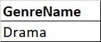
DISPLAY THE GENRE NAME ASSOCIATED WITH MAXIMUM NUMBER OF MOVIES
SELECT GENRE.GenreName from GENRE, BELONGSTO
where GENRE.GenreID = BELONGSTO.GenreID GROUP BY GENRE.GenreName
having count(genre.GenreName) = (SELECT MAX(NO_OF_MOVIES) FROM (SELECT GENRE.GenreName, COUNT(*) NO_OF_MOVIES FROM GENRE,BELONGSTO WHERE GENRE.GenreID=BELONGSTO.GenreID GROUP BY GENRE.GenreID) SubTable);

Slide 45
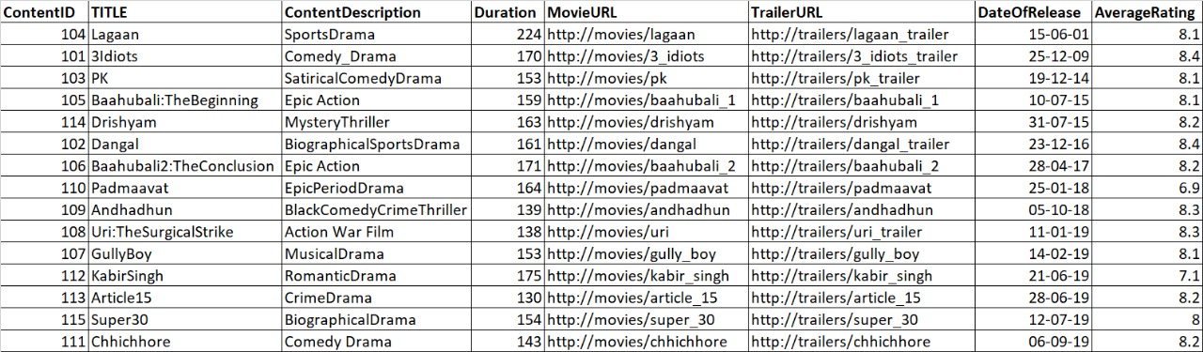
DISPLAY THE LIST OF MOVIES IN ASCENDING ORDER OF THEIR RELEASE DATES
SELECT * FROM CONTENT ORDER BY DateOfRelease;

Slide 46
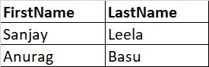
DISPLAY THE NAME OF THE DIRECTOR WHO HAS DIRECTED THE LEAST RATED MOVIE
SELECT DR.FirstName, DR.LastName FROM director DR, content C, directed DD WHERE DD.DirectorID = DR.DirectorID AND DD.ContentID = C.ContentID AND C.AverageRating = (SELECT MIN(C.AverageRating) FROM director DR,content C,directed DD WHERE DD.DirectorID = DR.DirectorID AND DD.ContentID = C.ContentID);

Slide 47
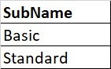
DISPLAY THE SUBSCRIPTION name WHICH HAS BEEN PRUCHASED BY MAXIMUM NUMBER OF USERS
SELECT SubName FROM subscription WHERESubID in ( SELECT SubID FROM USERS GROUP BY SubID HAVING COUNT( * ) = ( SELECT MAX(CNT) FROM ( SELECT SubID, count(*) CNT FROM USERS GROUP BY SubID ) SubTable ) );

Slide 48
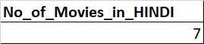
DISPLAY THE NUMBER OF MOVIES AVAILABLE IN HINDI
SELECT COUNT(*) No_of_Movies_in_HINDI FROM content NATURAL JOIN content_languages WHERE Languages="HINDI";

Slide 49
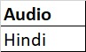
DISPLAY the language in which most content has been seen in the kids’ profile.
SELECT Audio FROM watchprofile WHERE PofileType="KIDS" GROUP BY Audio HAVING COUNT( * )=(SELECT MAX(CNT) FROM (SELECT AUDIO,COUNT(*) CNT FROM watchprofile WHERE PofileType="KIDS" group by AUDIO) SubTable);

Slide 50
THANK YOU

